Slide 1

Product Space PM Fellowship Teardown & Industry Benchmarking
Comparative UX/Content Analysis & Strategic Recommendations
By Shreya Bhuwania (VIT University 21BCE11266)

Slide 2
Agenda
1
About Product Space
2
Competitive Benchmarking
3
User Persona & Journey
4
Pain Point Prioritization
5
Feature & UX Comparison
6
Metrics & SWOT Analysis
7
Final Strategic Recommendations

Slide 3
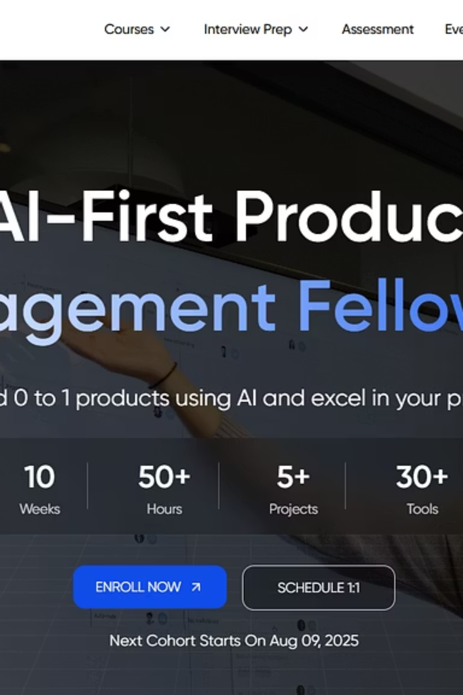
About Product Space
Launched: 2022
Differentiator: AI-stack integrated workflow, 1:1 mentor access, proof-of-work product launches
Core Offering: Cohort-based, AI-first Product Management Fellowship
Target Audience: Students, freshers, young PM aspirants
Placement Support: 1 year, interview prep, resume coaching

Slide 4
Competitive Landscape
Platform
Year
Audience
USP
Product Space
2022
Students/Freshers
AI-first PM with project delivery
HelloPM
2021
Young professionals
Mentorship-driven, case-based
Upraised
2019
Career switchers
Strong placement + job guarantee
NextLeap
2021
Broad tech audience
Peer learning, upskilling stack

Slide 5


User Persona: Arjun Sharma
👤 Persona 1: Arjun Sharma
👩‍💻 Persona 2: Priya Desai
Profile: Final-year CS student, BITS Goa. Seeking first PM role.
Profile: 4-year experienced Software Engineer. Seeking PM career pivot.
Goal: Secure PM role via hands-on training & placement.
Goal: Transition into strategic PM role, leverage tech background.
😬 Pain Points (Current Page):
😬 Pain Points (Current Page):
Information overload, dense text
Unclear AI-first differentiation/value
No visible placement proof (company logos)
Lack of ROI/salary increment data for experienced hires
Unsure if program fits a fresher's level
Uncertainty about cohort diversity (mix of experience)
🙌 Needs:
🙌 Needs:
"At-a-glance" program summary (fee, duration, outcome)
Clear value of AI-stack for experienced professionals
Real proof of outcomes (alumni logos, success stories)
Success metrics/testimonials from career switchers
Clear project-based learning and AI tool integration
Info on networking, mentorship quality

Slide 6





Journey Mapping: Intent → Decision
Phase
User Action
User State
Pain Point (Current Page)
Opportunity (Redesign)
Landing
Scans top fold
Overwhelmed / Curious
No quick program summary; unclear AI value
"At-a-Glance" card; concise AI value prop
Exploring
Reads content
Skeptical / Evaluating
Text-heavy curriculum; generic testimonials
Modular curriculum; diverse alumni stories
Evaluating
Seeks outcomes
Anxious / ROI-Focused
Missing visual placement proof / growth data
"Alumni At" section with logos & growth stats
Considering
Finds details
Frustrated
Unclear pricing; inconsistent CTAs
Transparent fees; prominent, sticky CTA
Decision
Nears conversion
Hesitant
Lacks trust signals / urgency
Trust badges; conversion urgency (e.g., cohort countdown)

Slide 7




Prioritized Pain Points (ICE Score)
No Placement Evidence
1
Impact: 9, Confidence: 9, Ease: 8, ICE score: 648
Long, Unstructured Layout
2
Impact: 8, Confidence: 8, Ease: 8, ICE score: 512
Inconsistent CTA Buttons
3
Impact: 7, Confidence: 8, Ease: 8, ICE score: 448
Overloaded Testimonial Section
4
Impact: 6, Confidence: 8, Ease: 9, ICE score: 432

Slide 8
Competitor Comparison
Factor
Product Space
HelloPM
Upraised
NextLeap
Curriculum Clarity
❌ Text-heavy
✅ Modular
✅ Tabs
✅ Step-based
Placement Proof
❌ Missing logos
⚠️ Quotes only
✅ Logo grid
⚠️ Selective
UX Layout
Weak visual hierarchy
Very clean
Sleek/sales-ready
Visual cards
CTA Design
❌ Sporadic
✅ Sticky CTA
✅ Repeated CTA
✅ Obvious
AI Stack
✅ Core offering
⚠️ Supplements
❌ Not focused
❌ Not prominent

Slide 9
Metrics Evaluation Framework
Why was this feature/page built? → To convert student traffic into full-time PM fellows
How to know they’re aware? → Awareness = Page visits, time on page
How to know they're using it? → Adoption = Form fills, mentor call requests, project submission
Metrics Table: (No actual metrics as I dont have the data)
Success Metric
# Interviews prepped, % PM placed
Awareness Metric
% landing visitors scroll to curriculum block
Adoption Metric
Form fills, mentor sessions scheduled

Slide 10








SWOT Analysis – Product Space
Weaknesses
Strengths
Dense info display, poor CTA design
AI-first hands-on PM curriculum
No proof of alumni conversions
Strong mentor community & 1:1 access
Generic, Cluttered testimonial section
Real project delivery experience
Inconsistent and unoptimized Call-to-Action (CTA) design
Comprehensive 1-year placement support
Ambiguous value proposition/fit for diverse experience levels
Opportunities
Threats
Optimize UX for conversion journeys
HelloPM & Upraised scaling fast
Add trust markers (logos/data)
User churn from info overload/ unclear value
Leverage AI-first aspect more visually
Enhance mobile responsiveness
Rising niche PM program competition
Segment content for persona-specific needs
Shifting market demands for PM skills

Slide 11
Final Strategic Recommendations
🟡 Short-Term
🟢 Mid-Term
🔵 Long-Term
Top-Fold At-a-Glance Card: Show duration, fee, next cohort start date, and key outcome in one quick summary box at the top.
Modular Curriculum View: Use tabs or accordions for each module to reduce page length and improve user focus.
Dynamic Impact Metrics: Live placement data, average salary hikes, and cohort diversity statistics.
Consistent Sticky CTA: Uniform “Apply Now for Aug Cohort” button that stays visible.
Segmented Testimonials: Filter by “Students,” “Career Switchers,” or “AI-Focused PMs” with short impactful quotes.
Personalised Content: A/B test hero headlines or program highlights for different segments visiting the page.
Placement Proof: Add company logos of alumni placements and a headline like “83% placed at leading firms”.
Visual Fellowship Roadmap: Add an infographic showing key stages (Foundation ➔ Build ➔ Launch ➔ Place).
Enhanced Mobile UX: Redesign for faster loading, bigger CTA buttons, and better card-based layout.

Slide 12

Thank You !
Prepared by Shreya Bhuwania
https://www.linkedin.com/in/shreyabhuwania03/

